Slide 1

MongoDB – A NoSQL Database
Guided By :
Prof. Hitendra.S.Khairnar
Presented By :
Sreeja Mohan (3471)
T.E. Computer-B

Slide 2
Agenda
Introduction to MongoDB
Features
Architecture
Documents and Collections
Data model
Replication
Sharding
Querying
Comparison
Applications
Advantages and drawbacks
Summary

Slide 3
Introduction to MongoDB
From “humongous”
Part of the “NoSQL” class of DBMS
Open source, document-oriented database
Not relational and schema free
Written in C++
Manages hierarchical collection of BSON (bee-son) documents
Scalable with high-performance (scales horizontally)
BASE rather than ACID compliant
Replication
Sharding

Slide 4

Motivation
Modern application are more networked, social and interactive.
This is driving new requirement to support
Big data
Fast feature development
Flexible deployment strategy.

Slide 5
Features
High performance
Availability
Power
Ease of use
Scalability
Flexibility
Speed

Slide 6
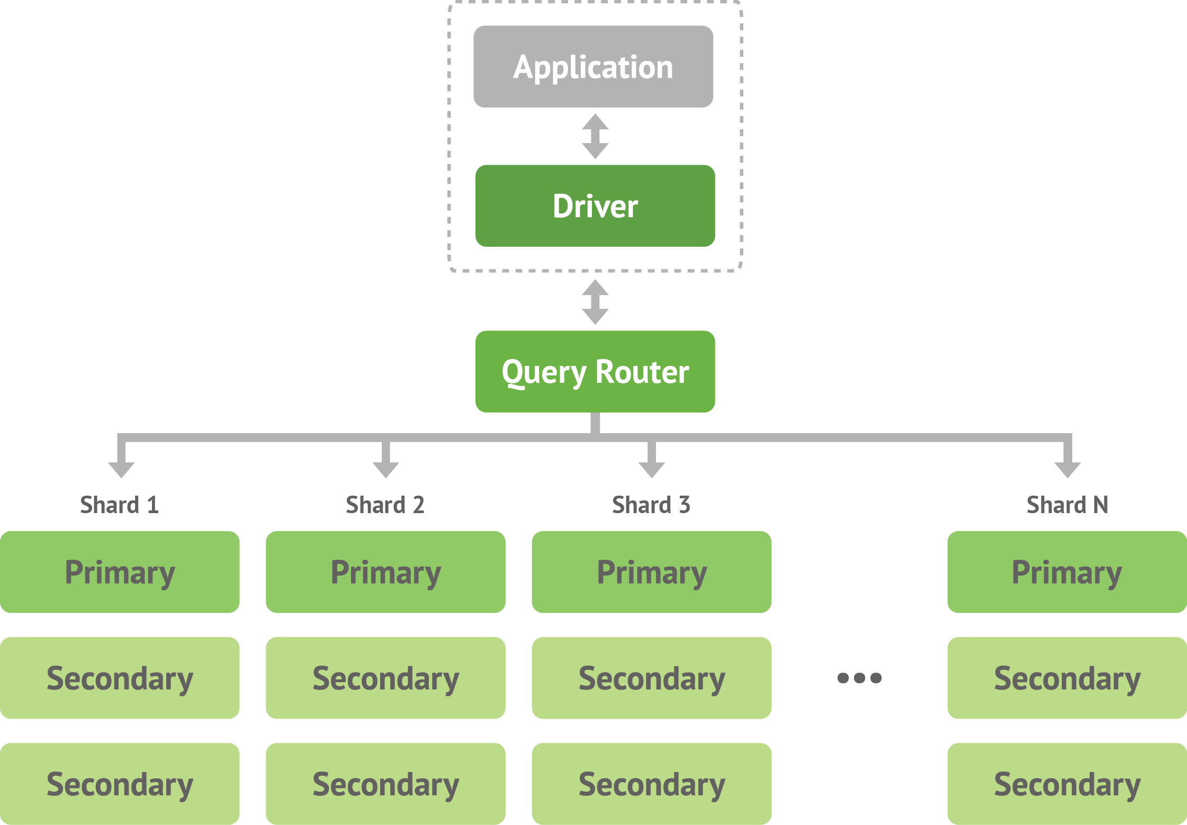
Architecture

Slide 7
Documents and Collections
A database holds a set of collections
A collection holds a set of documents
Documents are the records
Like objects in OOP, rows in RDBMS
Collections are groups of documents
Like RDBMS tables
Heterogeneous set
Unlike RDBMS tables, no pre-defined schema
No foreign keys
Just embed the sub-item in the parent document

Slide 8
Data Model
BSON is binary JSON
JSON is JavaScript Object Notation
BSON is a computer data interchange format.
Using BSON, developers can easily map to modern object-oriented languages without a complicated ORM layer.
BSON is a binary format in which zero or more key/value pairs are stored as a single entity.
It is lightweight, traversable, efficient.
Notes:
Object-relational mapping (ORM, O/RM, and O/R mapping) in computer software is a programming technique for converting data between incompatible type systems in object-oriented programming languages.

Slide 9

Embedded Objects
Documents can embed other documents
Used to efficiently represent a relation
For example
{
name : ‘Shipra Shinde’,
address :
{
street : ‘Oak Terrace’,
city : ‘Pune’
}
}

Slide 10
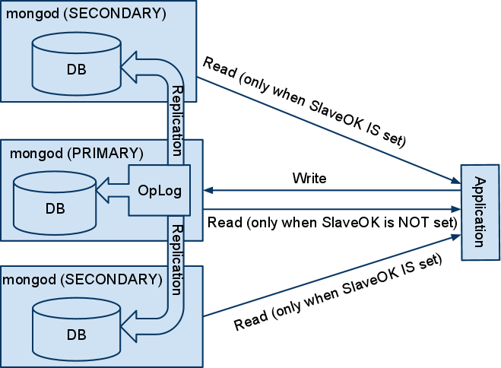
Replication
Replication is the tool for data safety, high availability, and disaster recovery.

Slide 11
Replication
Replica sets are a functional superset of master/slave and are handled by much newer, more robust code.
Only one server is active for writes (the primary).
One can optionally send read operations to the secondaries when eventual consistency semantics are acceptable.
write
Asynchronous
replication
Primary
read
Secondary
read
Secondary
read

Slide 12
Read Scalability : Replication
read
Replica Set 1
Primary
Secondary
Secondary
write

Slide 13
Replica Sets
Data Redundancy
Automated Failover
Read Scaling
Maintenance
Disaster Recovery

Slide 14
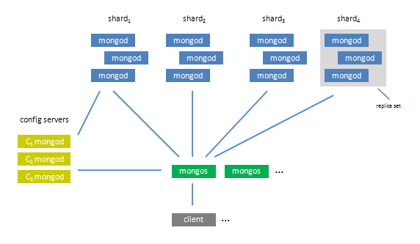
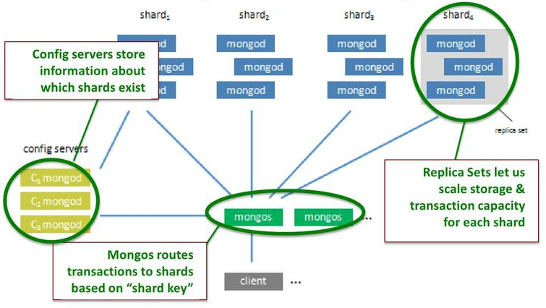
Sharding
Sharding is the partitioning of data among multiple machines in an order-preserving manner.
The set of servers/mongod process within the shard comprise a replica set.
Sharding is the tool for scaling a system.

Slide 15
Write Scalability : Sharding
read
Key range
0 .. 30
Key range
31 .. 60
Key range
61 .. 100
Replica Set 1
Replica Set 2
Replica Set 3
Primary
Primary
Primary
Secondary
Secondary
Secondary
Secondary
Secondary
Secondary
write

Slide 16
Querying
help – displays the mongodb help
db.help() – displays help related to the db creation
use db2 – command for database creation
db2.stud.save( { “first name” : “Sreeja” , ”last name” : “Mohan” , “div” : “B” } ) – command for creation of collection as well as insertion of document into it
x = { “first name” : “Shipra” , ”last name” : “Shinde” , “div” : “B” } – creates an object
db2.stud.save(x) – object is added to collection
db2.stud.find() – displays all the documents

Slide 17
Querying
db2.stud.find() – displays all the documents
db2.stud.find( { “first name” : “Sreeja” } ) – for displaying a particular document
db2.stud.remove({ “first name” : “Sreeja” } ) – for removing a document from collection
a = { “area” : “Sangvi” , “city” : “Pune” } - object
x.addr = a – embedding document
Result = { “first name” : “Shipra” , ”last name” : “Shinde” , “div” : “B” , “addr” : { “area” : “Sangvi” , “city” : “Pune” }}
explain() – explains how the query was executed

Slide 18
Comparison
Cassandra and HBase are the other popular NoSQL databases.
Comparison with Oracle
Operation | Cassandra | HBase | MongoDB
Insert-only | 21000 | 10000 | 6000
Read-only | 2500 | 3000 | 1000
Read- and-update | 6000 | 2500 | 250
No. of records | Oracle Database | MongoDB
10 | 31 | 800
100 | 47 | 4
1000 | 1563 | 40
10000 | 8750 | 681

Slide 19
Giant Applications
All use NoSQL in one way or another because of the significantly different challenges in dealing with huge quantities of data that the traditional RDBMS solutions could not cope with.
Facebook
Netflix
Google
CERN

Slide 20
Relational Vs Doc-oriented
Users
Graph
Users
Id | Name
1 | Sreeja
2 | Shipra
3 | Sayali
From | To
1 | 2
1 | 3
2 | 1
3 | 2
{ id : 1, name : “Sreeja”,
from : [2], to : [2,3] }
{ id : 2, name : “Shipra”,
from : [1,3], to : [1] }
{ id : 3, name : “Sreeja”,
from : [1], to : [2] }
Vs
To find all the ‘to’ edges for user 2
From | To
1 | 2
1 | 3
2 | 1
3 | 2
Users
{ id : 1, name : “Sreeja”,
from : [2], to : [2,3] }
{ id : 2, name : “Shipra”,
from : [1,3], to : [1] }
{ id : 3, name : “Sreeja”,
from : [1], to : [2] }
Blocks
Potentially as many disk seeks as “to” edges
1 disk seek guaranteed

Slide 21
Advantages
Map / Reduce
Capped Collections
Tail-able Cursors
Geo Indexing
Mechanism to aggregate all dataset.
Maintain insertion order for docs in collection.
Querying the data and data points that are near to one’s location.
Listen on result set ; as the changes happens ,one can propagate with those changes.
Circular buffer, for last hour log information.

Slide 22
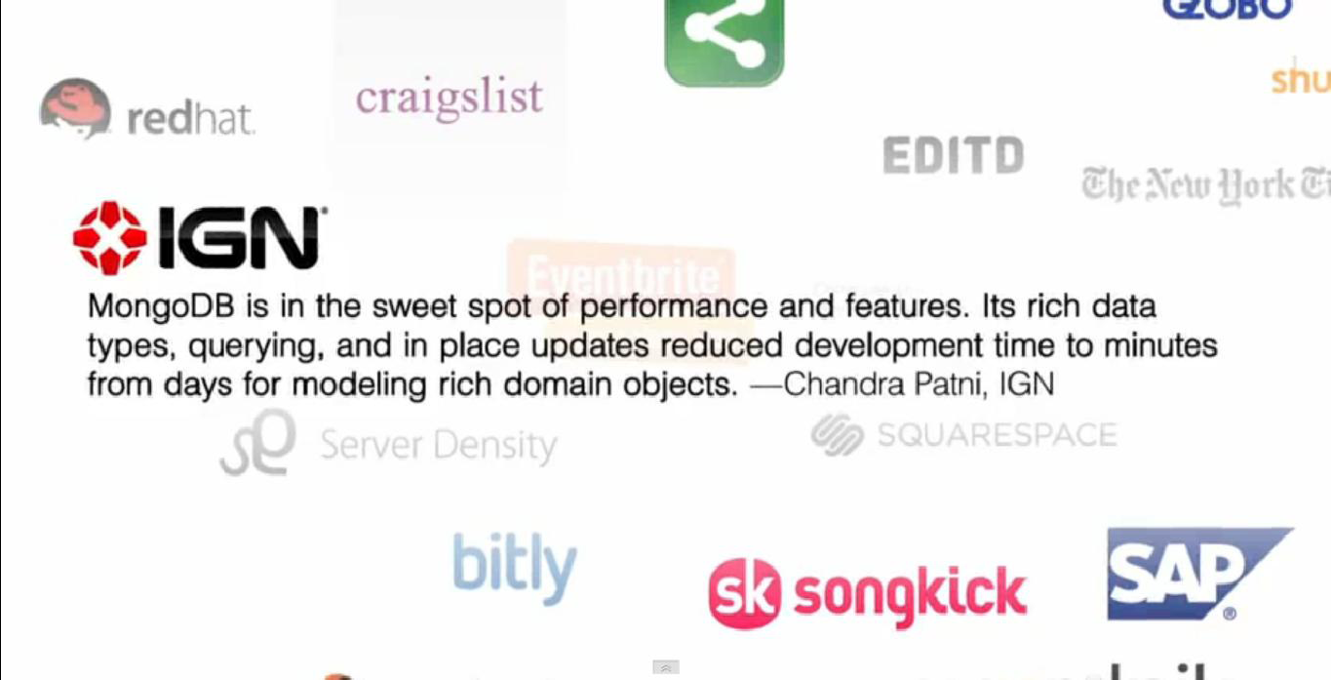
Why everybody’s scaling out ?

Slide 23
Drawbacks
It's not nearly as battle-tested or mature as MySQL.
Very unreliable.
No single server durability.
Repair takes a lot of time
Only way to be fully secure is to have 2 replicas in different data centre's.
Indexes take up a lot of RAM.

Slide 24
Summary
Open source
Document-oriented database
JSON-like documents with dynamic schemas
High performance
High availability
Easy scalability
Rich query language
Disadvantage are unreliable ,not mature, Indexes take up a lot of RAM
Companies large and small rely on MongoDB for storage of their mission critical data

Slide 25
Questions ?

Slide 26
Thank you

